Slide 1




DUBLIN: Visual Document Understanding By using Language-Image Network
Kriti Aggarwal*, Aditi Khandelwal*, Kumar Tanmay*, Owais Mohammed Khan, Qiang Liu, Monojit Choudhury,
Hardik Hansrajbhai Chauhan, Subhojit Som, Vishrav Chaudhary, Saurabh Tiwary
Microsoft Turing
Industry Track
Notes:
Hello everyone, I'm Tanmay, and today I’m excited to share our paper titled 'DUBLIN: Visual Document Understanding by using Language-Image Network.’ . This work has been accepted in the EMNLP Industry Track. Let’s discuss more about this paper.

Slide 2
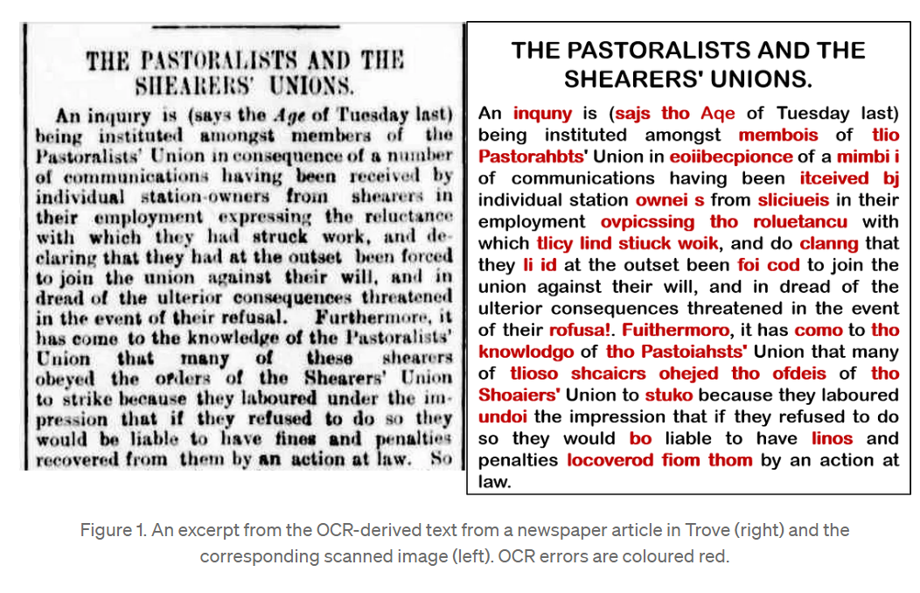
Introduction
Why we need an OCR free model?
Computationally expensive
Error-prone Text Recognition
Inability to handle Rich Visual Cues
Notes:
Unlike traditional methods using OCR tools in the input pipeline, our approach eliminates the need for text extraction, reducing computational costs and overall latency. OCR tools often falter with poor-quality or complex documents, as seen in the example provided. Additionally, they struggle with pictures containing rich visual elements. Our model aims to overcome these limitations, offering a faster and more accurate solution for comprehending visually-rich documents.

Slide 3
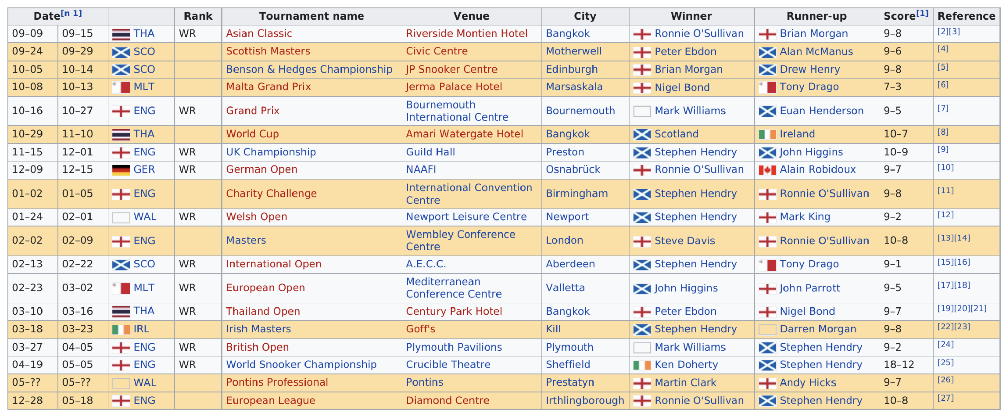
Introduction
DUBLIN is a Pixel-based OCR-Independent Visual Document Understanding Model
Pretrained on large number of Webpages and Rendered Images
Handles diverse tasks like Question-Answering, Information Extraction, Classification, Image Captioning, Machine Reading Comprehension, Bounding box - Text prediction, Natural Language Inference
Understands and processes various kinds of document images like infographics, charts, forms, tables, natural images, webpages, UI, plain-text
Achieved SOTA performances by a significant margin (AI2D - 24% ↑, InfographicsVQA - 7.5% ↑, DocVQA - 5.35% ↑)
Question: What is the name of the first venue on this list? DUBLIN’s Answer: Riverside Montien Hotel Gold Answer: Riverside Montien Hotel
Notes:
DUBLIN is a Pixel-based OCR-Independent model, which has been pre-trained on webpages and rendered images for tasks like Question-Answering, Information Extraction, Classification, and Image Captioning and so on. DUBLIN handles diverse document types like infographics, charts, forms, tables, natural images, and even plain text. Our meticulous pretraining and data processing strategies lead to state-of-the-art performance, surpassing benchmarks like AI2D, InfographicsVQA , and DocVQA by significant margins.

Slide 4
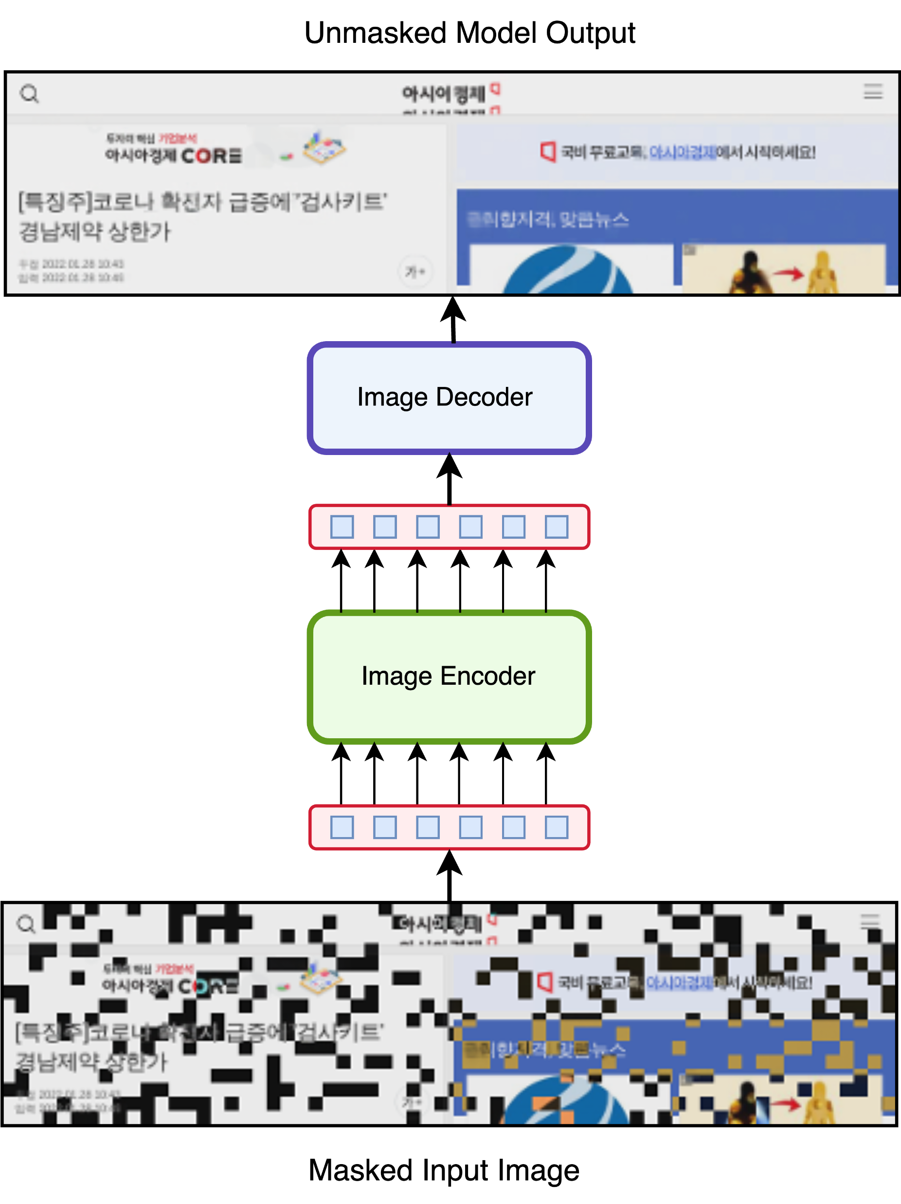
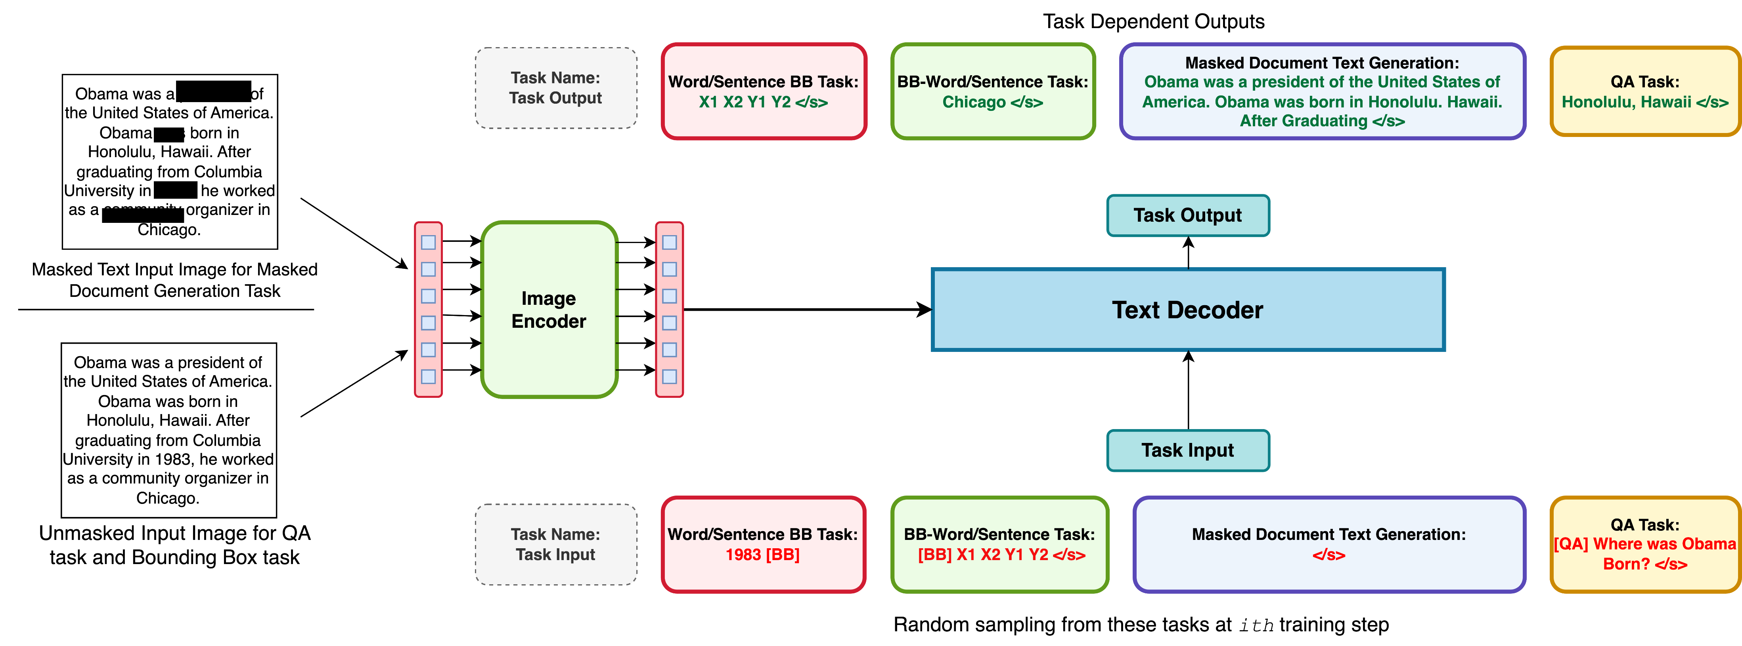
Model Pretraining Framework
Figure 1
Figure 2
Notes:
DUBLIN is an end-to-end system with 976 million parameters, having a Turing-Bletchley image encoder and a text decoder initialized from InfoXLM. Cross-attention layers enable dynamic interaction between visual and textual modalities. In our pretraining, we target four objectives: language, image, document structure, and question-answering. The left figure shows the masked autoencoding task, focusing on training the image encoder initially. The second figure highlights subsequent strategies: masked document text generation, bounding box tasks, and question answering. Each objective significantly contributes to capturing complex visual document structures, enhancing the model's comprehension and reasoning.

Slide 5
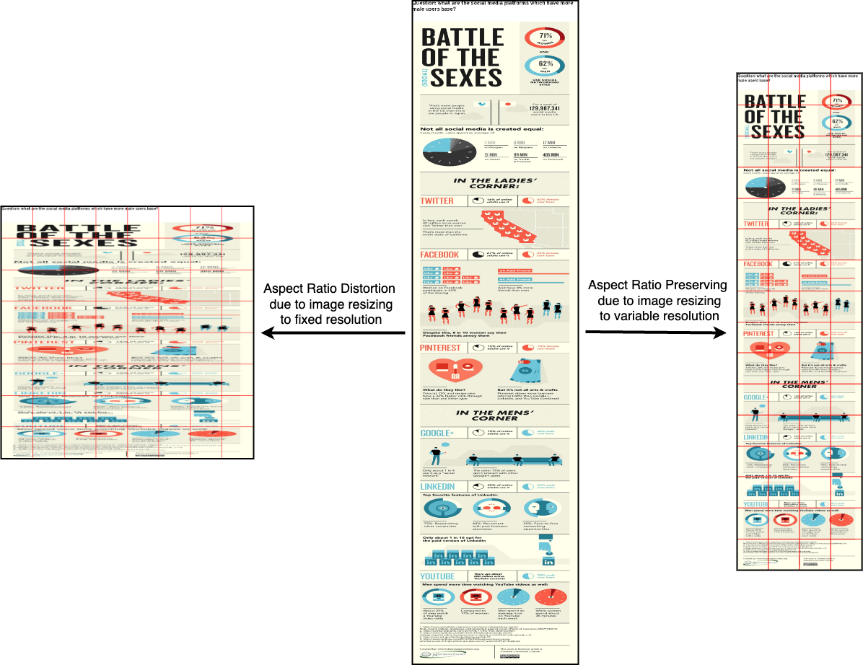
Pre-processing Techniques before Finetuning
Question on top of the images
Variable Input Resolution to handle documents of different aspect ratios
Template based finetuning to execute different kinds of tasks without adding any external layers for specific tasks.
Notes:
Now, let's explore key pre-processing techniques crucial for efficient fine-tuning. First, we strategically place questions on images to boost contextual understanding. To handle diverse document aspect ratios, we use a Variable Input Resolution technique, providing flexibility for our model to adapt to various layouts. We also leverage Template-based fine-tuning, enabling task execution without task-specific external layers. The combination of these techniques yields state-of-the-art performance across diverse public benchmarks.

Slide 6
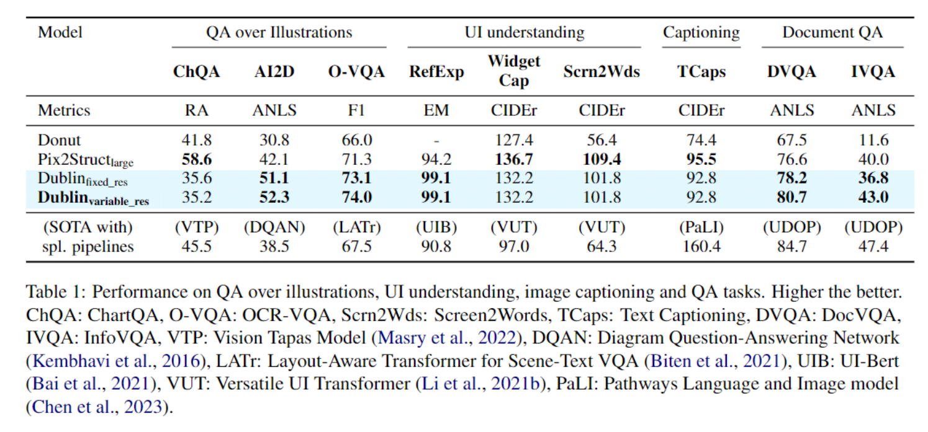
Results
Notes:
We evaluated our model’s performance using different public benchmarks and compared with pixel-based and specialized pipeline models. Our evaluation underscores DUBLIN's versatility and robustness.
A key highlight is the Fixed vs. Variable Resolution comparison, showcasing how Variable Input Resolution significantly improves performance, particularly with longer documents.

Slide 7
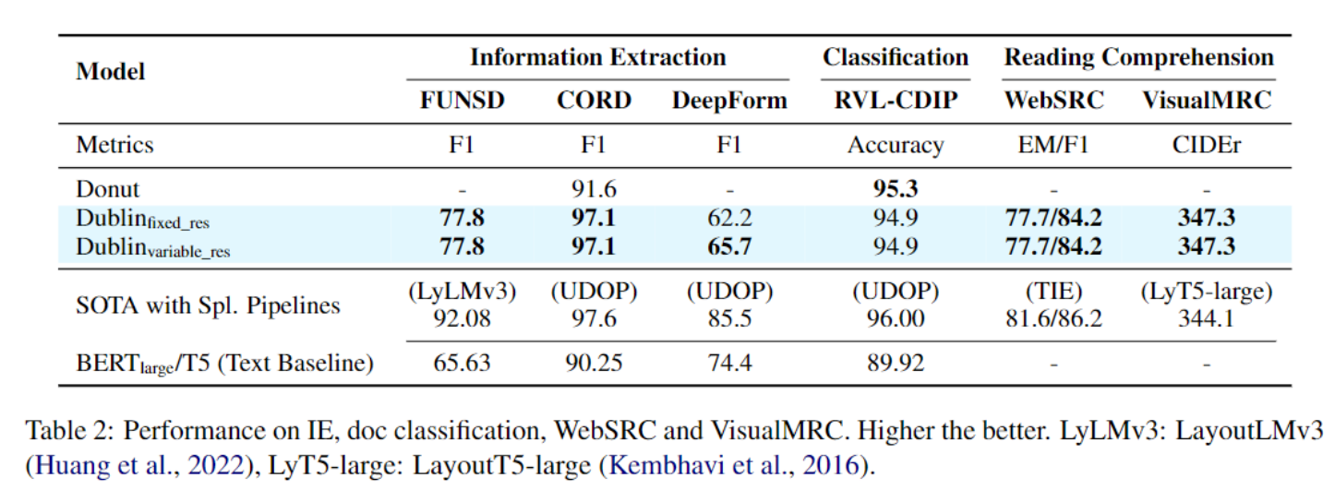
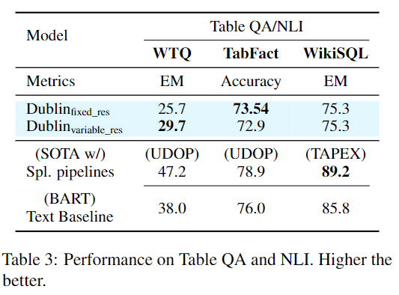
Results
Notes:
In Table 1, our model achieves comparable performances without using a specialized OCR pipeline for text extraction. DUBLIN showcases its proficiency in directly comprehending and processing information from visual cues. In Table 2, we shift focus to our model's performance in table understanding. Despite a gap compared to specialized pipelines, DUBLIN, as a vision-based model, still achieves noteworthy results.

Slide 8
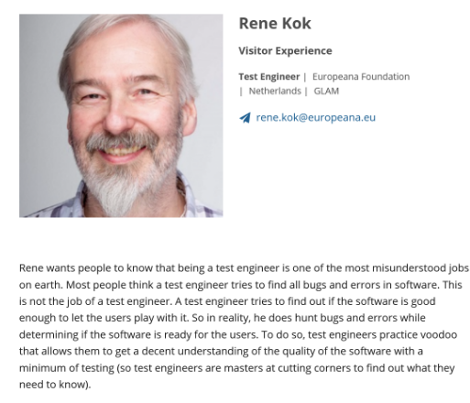
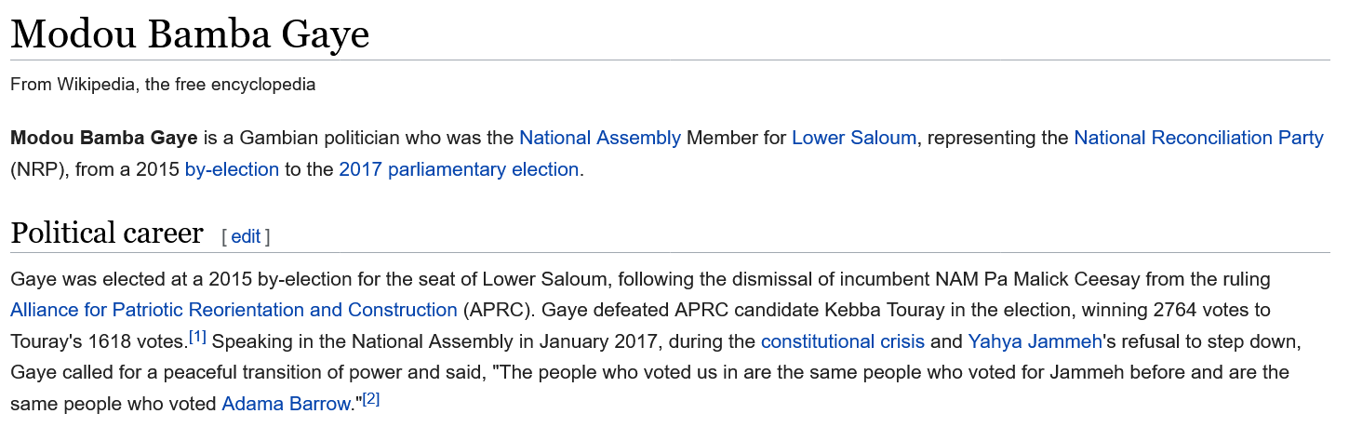
Examples
Question: What does Rene want people to know about being a test engineer? DUBLIN’s Answer: He wants people to know that being a test engineer is one of the most misunderstood jobs on earth. Gold Answer: That being a test engineer is one of the most misunderstood jobs on earth.
Question: When was Gaye elected for the seat of Lower Saloum? DUBLIN’s Answer: Gaye was elected at a 2015 by-election. Gold Answer: In 2015
Notes:
On this slide, we highlight some examples and DUBLIN's responses which showcases its exceptional ability in comprehending visual content and delivering high-quality, insightful answers to the questions.

Slide 9
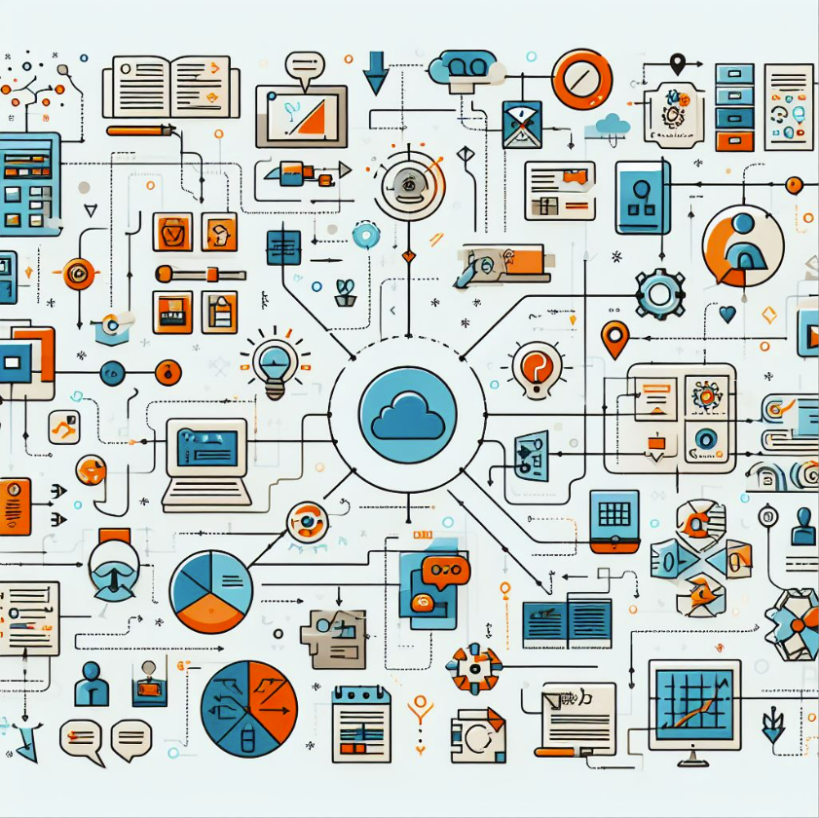
Conclusion
DUBLIN is a 976M parameter model which can handle diverse types of document images and perform different kinds of task.
DUBLIN is a versatile and robust model that does not rely on external OCR systems and can be finetuned in an end-to-end fashion.
We also introduce a new evaluation setup on text-based datasets by rendering them as images.
This model can be used in various applications, from search engines to presentations.
Possible future direction: Integrating Generative models like T-NLG or Llama models.
Notes:
In a nutshell: DUBLIN, with 976M parameters, handles all sorts of documents and tasks. It's versatile, and robust and doesn't rely on external OCR. Plus, it can be fine-tuned seamlessly. DUBLIN is useful in different applications, from search engines to presentations. One of the interesting future direction would be to integrate advanced language models like Turing-NLG or Llama which may further improve the model’s performance.

